Slide 1
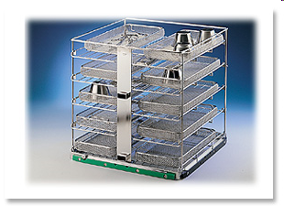
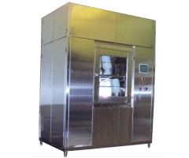
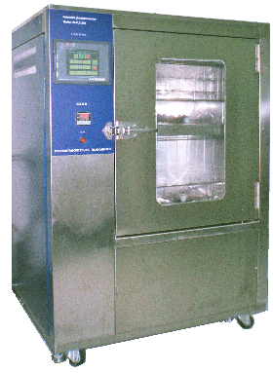
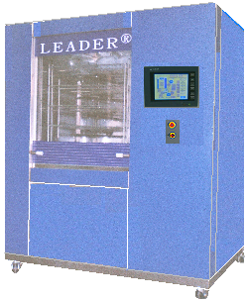
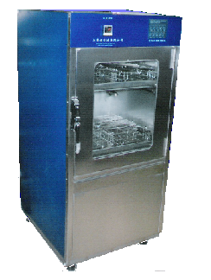
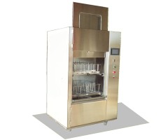

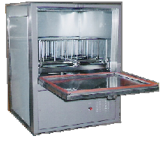
LEADER® MULTICHAMBER
MEDICAL TUNNEL WASHER
LEADER is a professional manufacturer Backed up by 30 years experience in the Asia area of laboratory, pharmaceutical and medical washing / disinfection. So, LEADER has designed ranges of professional washing machines intended to meet all your requirements
CE
TEL:2658-7810
FAX:2658-7801
E-mail:
leador.washer@msa.hinet.net
http: \\www.leader21tw.net
LEADER ULTRASONIC CO., LTD
TEL：02-2658-7810 FAX：02-2658-7801
E-mail：leador.washer@msa.hinet.net
1

Slide 2


LEADER® MULTICHAMBER MEDICAL TUNNEL WASHER
LEADER® LD-570T
The LEADER® LD-570T are especially designed for the CSR and offers due to the modular construction high efficient cleaning and best reprocessing results.
The machine can be made fit for purpose out of 1 – 4 independent elements: Cleaning-, Disinfection-, Ultrasound- and Drying units.
LEADER® LD-570T
Temperature
Thermal disinfection
Good mechanical efficient Cleaning
Pump spray and ultrasonic cleaning
Time
Wash time and process。
Chemical Dosing system Four liquid dosing pumps
LEADER® LD-570T：
Key features
> Up to 15 instrument trays [485x250x50mm]
> RS232 interface for printer- or PC connection
> Touch Monitor operator panel with 40 adjustable cleaning cycles
> Automatic powered full glass door (s)
> Washing and thermal disinfecting temperature adjustable up to [93ºC]
> Temperature monitoring by two independent PT-100 probes
> Exhaust steam condenser optional 。
Range of Use:
The machine is designed for cleaning the following parts:
1. glassware
2. drums and containers
3. surgical instruments.
4. MIS-Instruments
5. Rigid Endoscopes
6. Surgical Shoes
7. Ophthalmology
8. Anesthesia
2

Slide 3
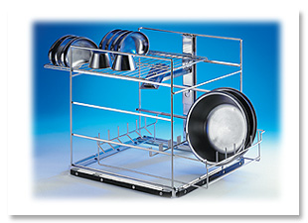
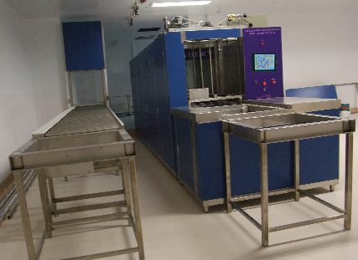
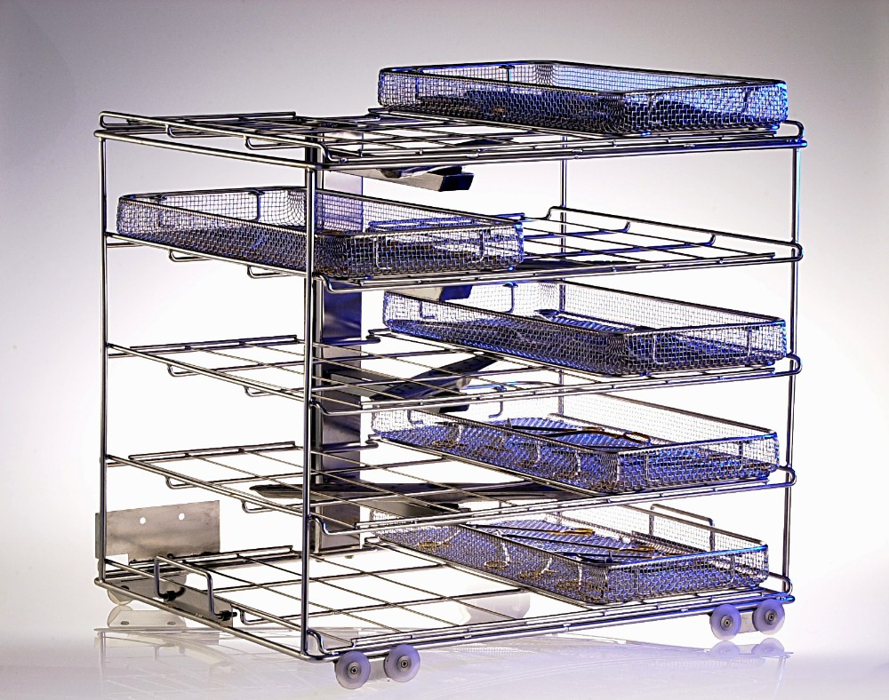
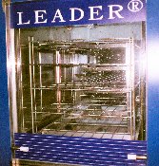
LEADER Medical Washer Disinfector LEADER® LD-570T
BASIN BASKETAND INSTRUMENT BASKET( Up to 15 DIN trays)
Extensive variants of equipment
-One-, Two-,Three-, Four-, module unit, vertical sliding doors
- Ultrasonic cleaning chamber
- Steam or electrical heating
- Monitoring of pump pressure, temperature, conductivity etc.
- Use of hollow jets with contact coupler to the basket (GMP rinse)
- High capacity HEPA filtered drying system
- Barcode reader for automatic basket identification
- Wide variety of baskets, customer specific manufacture
- Extensive automation, conveyors etc.
- Execution in ex-protection
glass door allow visual inspection of wash spray operation
3

Slide 4
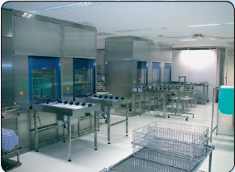
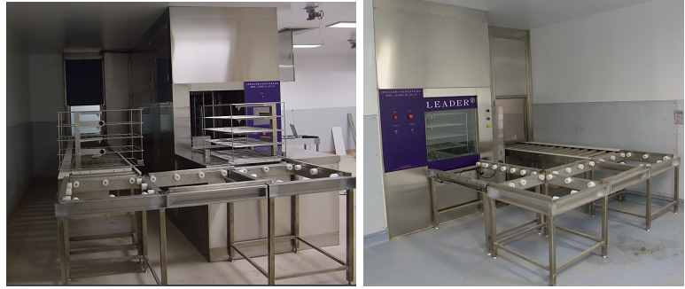
LEADER Medical Washer Disinfector LEADER® Model: LD-570TL (4 module)
LEADER® LD-570-3T(3CHAMBER)
Dimensions complete machine :
OVERALL：1060×1850×10600mm（W×H×D）
External: 1500/1850/6360 mm (W/H/L). (2700mmwith open door)
Wash chamber : 700/880/890 mm (W/H/D).
BASKET：640×660×860mm（W×H×D） Automatic powered full glass door allow visual inspection of wash spray operation
CONVEYOR SYSTEM
* Dimensions complete machine :1500/1850/5300 mm (W/H/L). (2700mmwith open door) Extendable with automatic loading and unloading options
10

Slide 5
Hospital use
Multi-Chamber Cleaning System for Spray Cleaning and Drying
LEADER® Tunnel Washer LD-570T
18

Slide 6
LEADER Medical Washer Disinfector LEADER® Model: LD-570TL (4 module)
LEADER® LD-570-3T(3腔式)
Dimensions complete machine :
OVERALL：1060×1850×10600mm（W×H×D）
External: 1500/1850/6360 mm (W/H/L). (2700mmwith open door)
Wash chamber : 700/880/890 mm (W/H/D).
BASKET：640×660×860mm（W×H×D） Automatic powered full glass door allow visual inspection of wash spray operation
CONVEYOR SYSTEM
* Dimensions complete machine :1500/1850/5300 mm (W/H/L). (2700mmwith open door) Extendable with automatic loading and unloading options
*根據不同的用途*可清洗不同的器械*清洗外科手術器械
*培養皿*彎盆、鴨嘴*不鏽鋼物品*塑膠製品*Silicon Suction Tube
10

